Slide 1



Technology Ambassador Program
Teaching Programming Fundamentals with Candy Catch
Anel Coralic, Austin Lainer, Carl Mickiewicz, Derek Phung
Notes:
Hello today we will be covering the Teaching Programming Fundamentals with Candy Catch Workshop, by TAP

Slide 2
TAP
The Technology Ambassadors Program (TAP) was created at Georgia Gwinnett College located in Lawrenceville, GA.
The TAP program addresses the need to increase the number of students who persist in an IT major or IT minor, particularly those underrepresented in computing.
The TAP program at GGC strives to break the misconceptions of the IT field by providing fun workshops for students of all backgrounds. TAP students design engaging and fun outreach workshops to encourage interest in IT and STEM.
Notes:
Tap is the Technology Ambassador program, the was created to bring awareness to the lack of students interested in the IT field. As part of tap we hope to break any misconceptions about the IT field grow interest through a variety of fun and engaging workshops.

Slide 3
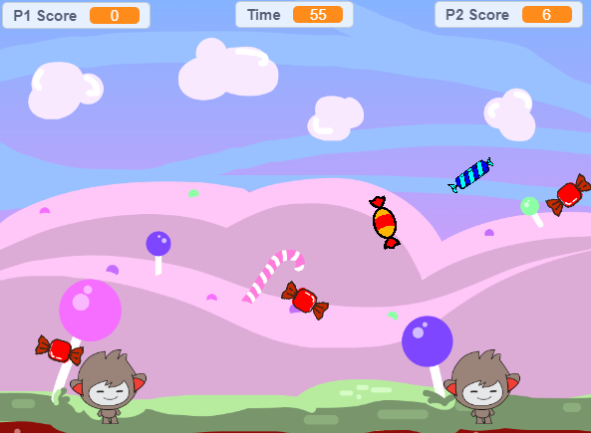
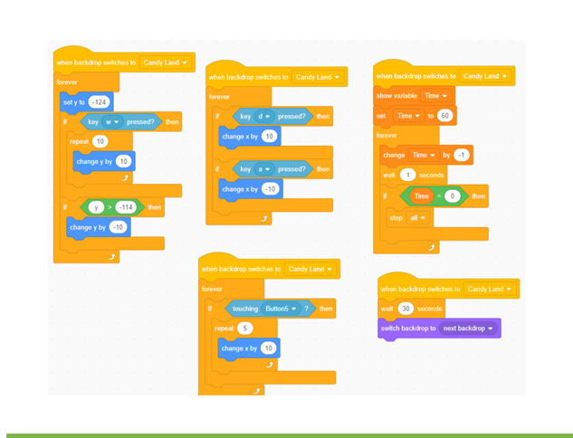
Project Description
This projects introduces game development by teaching students how to build basic block coding and simple concepts such as loops and if-then statements.

Slide 4

What is Scratch
Scratch is a block-coding based software used to introduce basic coding concepts to beginners through interactive games.

Slide 5

Block Coding
Block Coding utilizes a drag-and-drop learning environment where programmers use blocks to construct basic programs.
Concepts such as if/then statements and while loops are the basis for how these programs are developed.

Slide 6
Programming Concepts
If-Then Statement: An if-then statement is a concept that specifies the execution of an action when a condition is true, or another action is done. Example: “If I wash my hands, then they will be clean.”
While/Forever Loop: All the code in the loop will execute forever, as long as the program is running. A forever loop allows the candy in our game to constantly fall, rotate, and re spawn at the top of the screen. Example: “While the faucet is open, the water will keep running. Until I turn off the faucet”

Slide 7
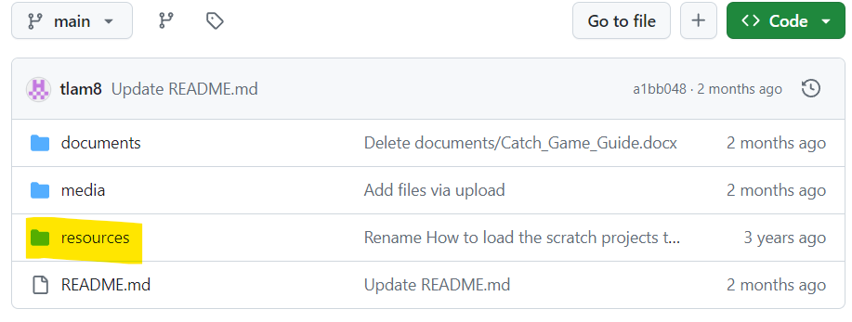
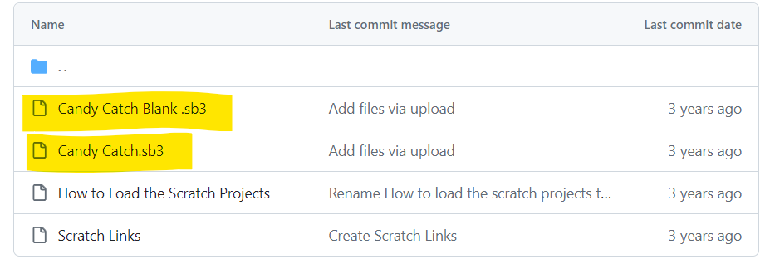
Before we begin…
First thing, head to the Scratchathon repository.
Once everyone is there, make sure to click on the resources tab.
Download both the Candy Catch.sb3 and Candy Catch Blank.sb3. (You may download the other files if needed)

Slide 8
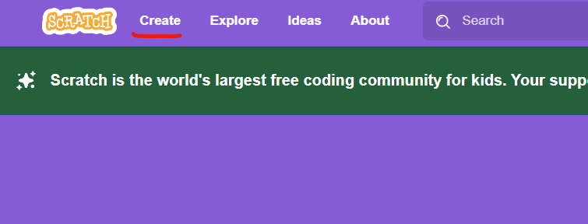
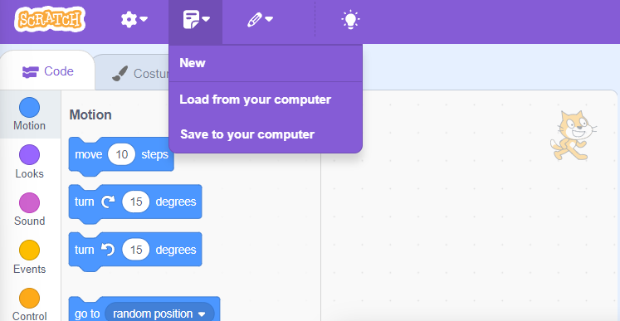
Preparing Scratch
Head to Scratch.mit.edu and click on CREATE on the top left corner.
Load the Candy Catch Blank.sb3 file by clicking on the file icon and load from your computer.
The page should still look empty but now we have the resources needed to create our own game.
You may load the Candy Catch.sb3 and experience what the game should look like before having them start

Slide 9
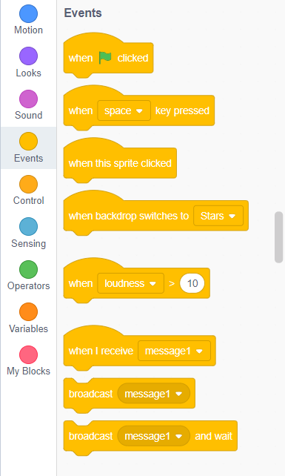
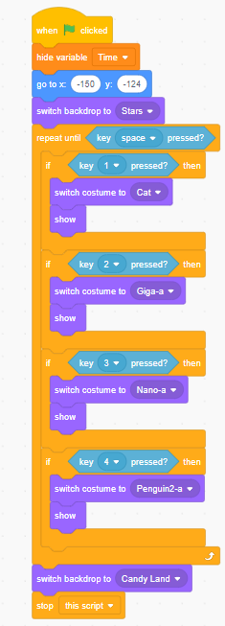
Making the game
Start with adding the event tab “When clicked”.
This will allow the game you create to launch.
Follow the rest of the code shown here or on the guide to create the rest of the code

Slide 10
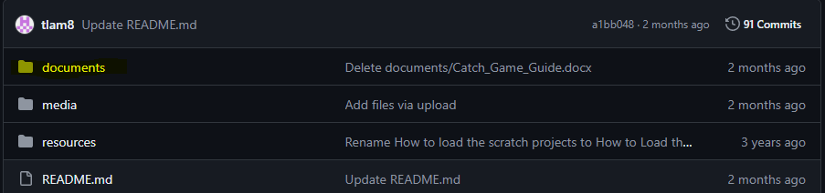
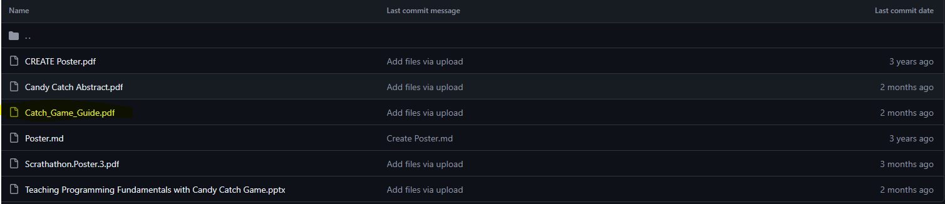
Instructions
Go back to the repository to download the step by step guide.
Locate the documents tab and select it.
From there download the Catch_Game_Guide.pdf
Follow the steps to create a Candy Catch Game

Slide 11
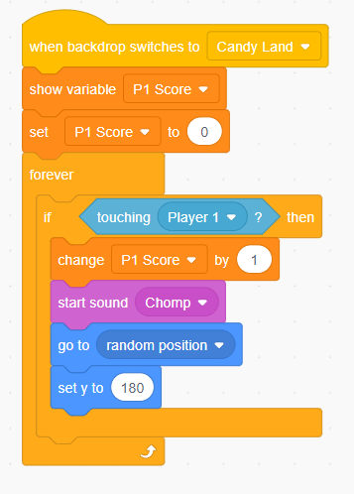
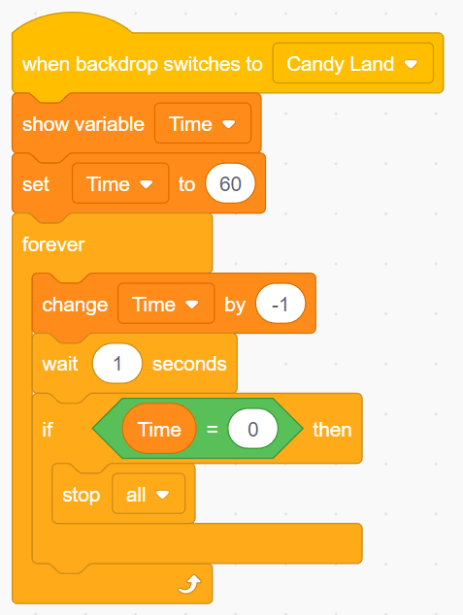
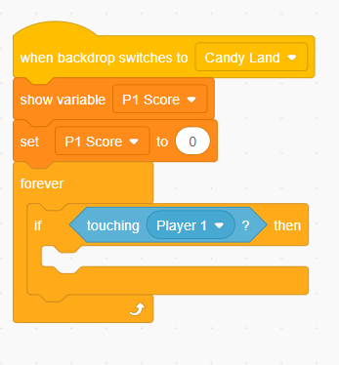
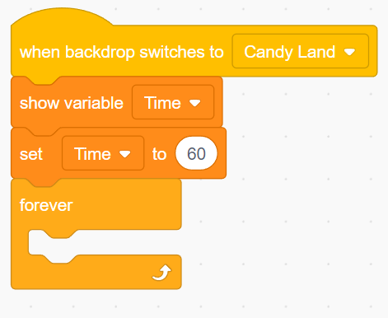
Instructions cont.
While students are creating their game ask questions to help guide them.
Example 1: How do you stop the game once the timer ends?
Example 2: How do you add a point system when a character gains a fruit?
Notes:
A forever loop in this first example will continuously count down the timer, and if the time reaches 0 then stop this block of code In the second example, if touching is used on the player 1 character to count a point total. So, when a fruit interacts with the character, their “score” goes up by 1.

Slide 12
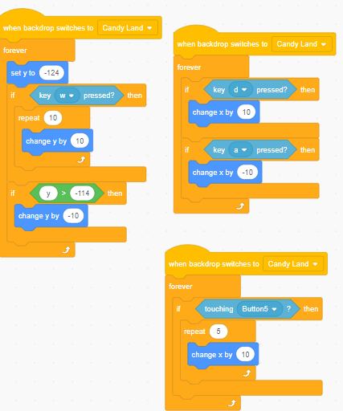
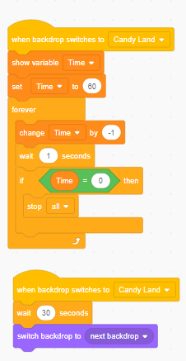
Solution

Slide 13
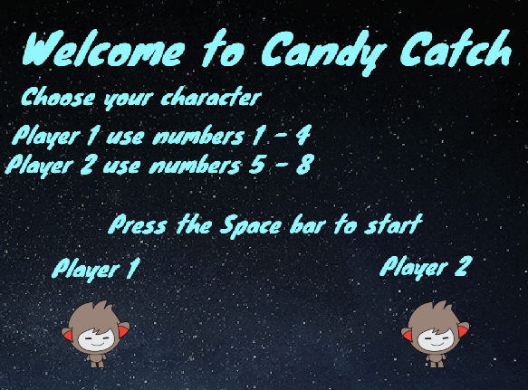
Time to Play!!!
From here spend 5-10 minutes playing the game
After that, play with the code:
Change timing/points
Add sprites/models
Change backgrounds
Create more difficult levels

Slide 14
Thank You
Please try out our other projects!!!

